Slide 1
Virtual Memory

Slide 2
Introduction
In our previous discussions, we assume that the entire program has to be transferred into the main memory, but in many cases, the entire program is not needed.
For example:
Code used to handle unusual error conditions is seldom being executed.
Certain options and features of a program may be used rarely.

Slide 3
Introduction
If only part of the program needs to be placed in the physical memory, then:
No constraint on program size.
More programs could be placed in the physical memory.

Slide 4
Introduction
Process 1
Process 1
Part of
Process 1
20M
Process 2
Part of Process 2
Process 2
Part of Process 3
14M
Process 3
Part of Process 4
Process 3
18M
Memory
Memory
Process 4
8M

Slide 5
Introduction
Virtual memory is a technique that allows the execution of process that is not completely in the memory.
Part of the program is in physical memory.
Part of the program is in the virtual memory (disk).
When only a smaller physical memory is available, a very large virtual memory can be provided for the programmers (disk space is cheaper).
Major advantages:
Program size can be larger than physical memory.
Free from the concerns of memory-storage limitations.

Slide 6
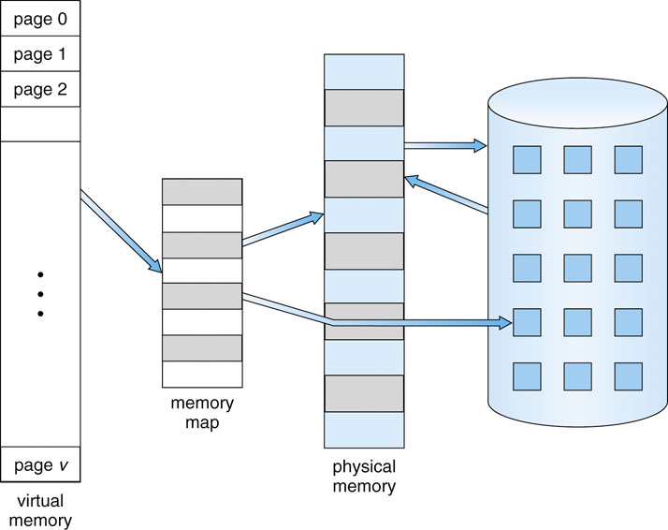

Slide 7
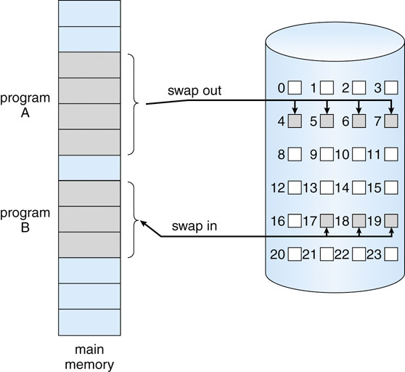
Demand Paging – Basic Concepts
Load pages only as they are needed.
Similar to paging system with swapping.
Swap in a page only when it is needed.
Pager to swap individual page.

Slide 8
Demand Paging – Basic Concepts
When a process is to be swapped into the main memory:
Pager determines which pages will be used.
Instead of swapping in the whole process, pager brings only pages that are needed into memory.
Avoids reading into memory pages that will not be used.
Decreasing swap time.
Decreasing amount of physical memory needed.

Slide 9
Page Replacement
What if no frame is free to put in the new page?
Need to do page replacement.
Find one that is not currently being used, and free it.
Write all the contents to swap space (usually on disk).
Change the page table to indicate that the page is no longer in memory.
Use the freed frame to hold the page for which the process faulted.
Restart the process.

Slide 10
Page Replacement & Thrashing
If the process does not have the number of frames to store all the pages that it is needed to run, then it will quickly page-fault.
At this point, it must replace some pages.
But since all its pages are also in active use, it must replace a page that will be needed again right away.
Consequently, it quickly faults again, and again…
This high paging activity is called thrashing.
A process is thrashing if it is spending more time on paging than executing.

Slide 11
Backing Store
0
A.0
1
A.1
2
A.2
3
A.3
A.5
4
B.0
A.3
D.0
5
B.1
D.1
A.5
6
B.2
D.2
7
C.0
A.6
8
C.1
C.4
9
C.2
10
C.3
C.5
11
D.3
B.3
12
D.4
13
B.1
B.4
14
B.2
Main Memory

Slide 12
Page Replacement Algorithms
Want lowest page-fault rate.
Evaluate algorithm by running it on a particular string of memory references (reference string) and computing the number of page faults and page replacements on that string.
In all our examples, we use a few recurring reference strings.

Slide 13
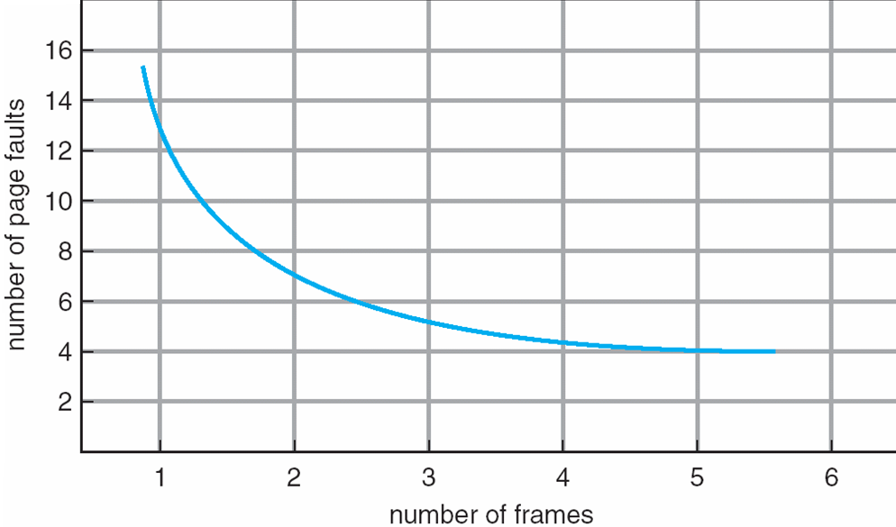
Graph of Page Faults vs. the Number of Frames

Slide 14
Page Fault
A page fault is a type of interrupt, raised by the hardware when a running program accesses a memory page that is mapped into the virtual address space, but not loaded in physical memory.

Slide 15
The FIFO Policy
Treats page frames allocated to a process as a circular buffer:
When the buffer is full, the oldest page is replaced. Hence first-in, first-out:
A frequently used page is often the oldest, so it will be repeatedly paged out by FIFO.
Simple to implement:
requires only a pointer that circles through the page frames of the process.

Slide 16
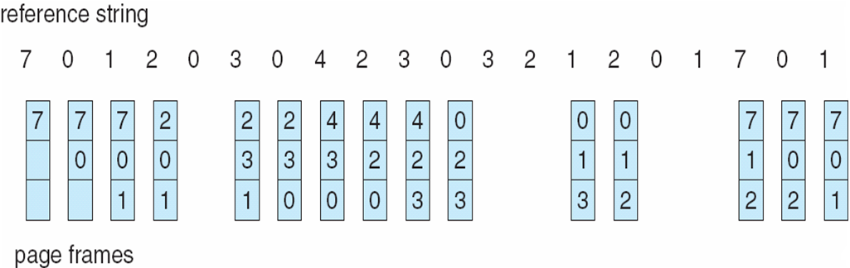
FIFO Page Replacement

Slide 17
First-In-First-Out (FIFO) Algorithm
Reference string: 1, 2, 3, 4, 1, 2, 5, 1, 2, 3, 4, 5
3 frames (3 pages can be in memory at a time per process):
4 frames:
FIFO Replacement manifests Belady’s Anomaly:
more frames ⇒ more page faults
1
1
4
5
2
2
1
3
9 page faults
3
3
2
4
1
1
5
4
2
2
1
5
10 page faults
3
3
2
4
4
3

Slide 18
Optimal Page Replacement
The Optimal policy selects for replacement the page that will not be used for longest period of time.
Impossible to implement (need to know the future) but serves as a standard to compare with the other algorithms we shall study.

Slide 19
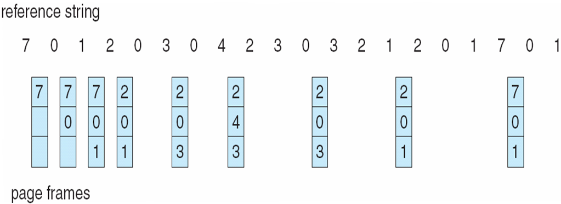
Optimal Page Replacement

Slide 20
Optimal Algorithm
Reference string : 1, 2, 3, 4, 1, 2, 5, 1, 2, 3, 4, 5
4 frames example
How do you know future use? You don’t!
Used for measuring how well your algorithm performs.
1
4
2
6 page faults
3
4
5

Slide 21
The LRU Policy
Replaces the page that has not been referenced for the longest time:
By the principle of locality, this should be the page least likely to be referenced in the near future.
performs nearly as well as the optimal policy.

Slide 22
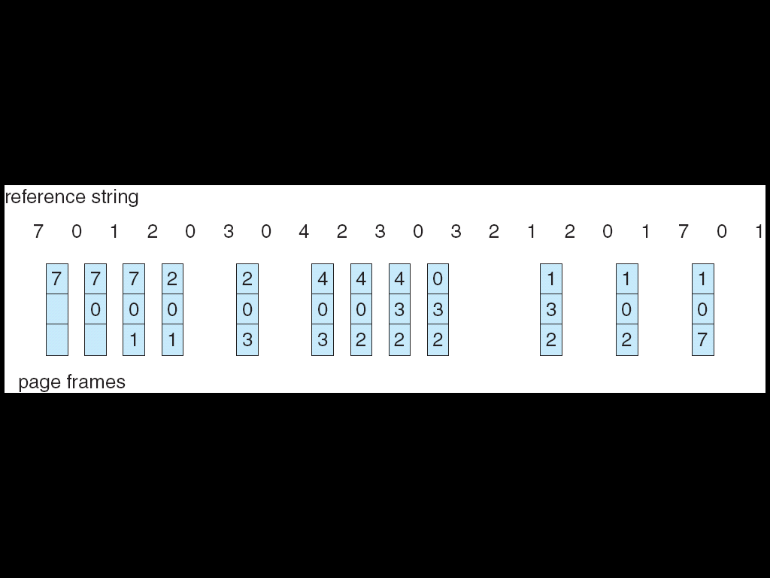
LRU Page Replacement

Slide 23
Least Recently Used (LRU) Algorithm
Reference string: 1, 2, 3, 4, 1, 2, 5, 1, 2, 3, 4, 5
1
1
1
1
5
2
2
2
2
2
8 page faults
3
5
5
4
4
4
4
3
3
3

Slide 24
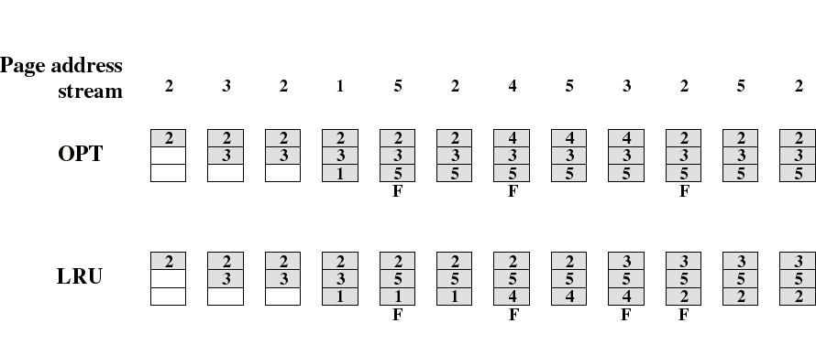
Comparison of OPT with LRU
Example: A process of 5 pages with an OS that fixes the resident set size to 3.

Slide 25

Comparison of FIFO with LRU
LRU recognizes that pages 2 and 5 are referenced more frequently than others but FIFO does not.

